Slide 1
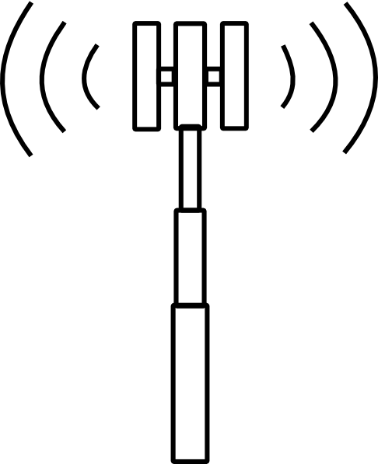
Reapproaching Property Rights and Wireless License Values
Connor Boone
Martin McNulty
Rushma Khatri
Idea adopted from:
Hazlett, T. (2008). Property Rights and Wireless License Values. The Journal of Law & Economics, 51 (3), 563-598.

Slide 2
Contents of Report
Background
Explanation of Variables
Valididity
Data Reporting
Explanations and Results

Slide 3
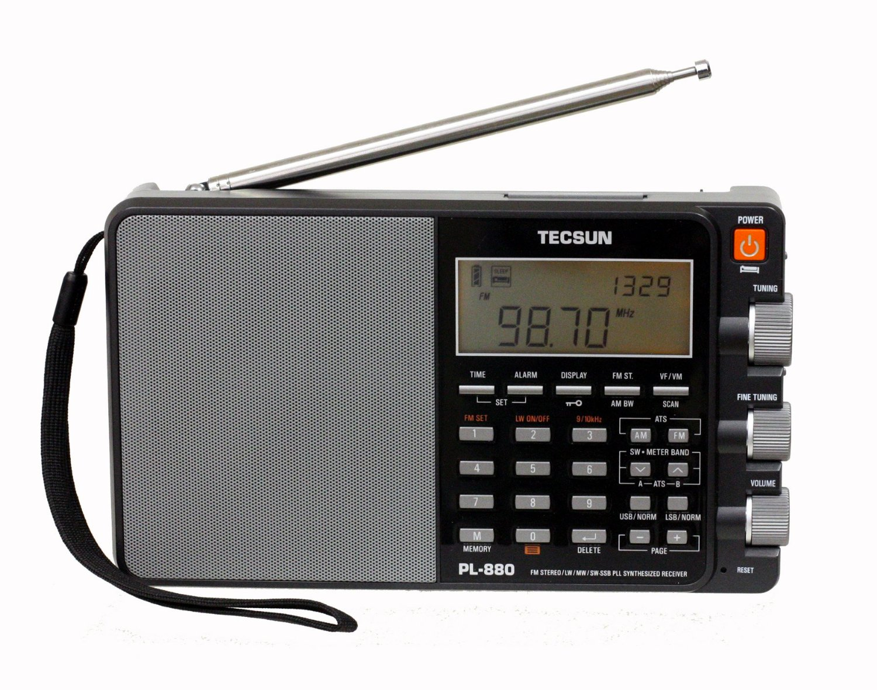
Background
The electromagnetic spectrum
^

Slide 4

!
BANDS
Governance

Slide 6
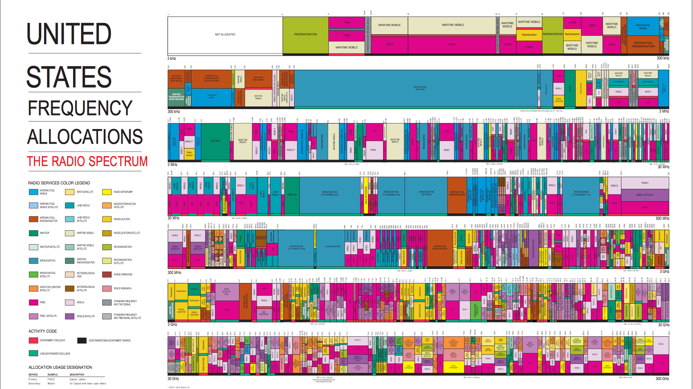
Image credit:
AUCTION 73

Slide 7
II. Explanation of Variables
i
j
Antigua and Barbuda
The Bahamas
Barbados
Belize
Canada
Costa Rica
Cuba
Dominica
Dominican Republic
El Salvador
Grenada
Guatemala
Haiti
Honduras
Jamaica
Mexico
Nicaragua
Panama
Saint Kitts and Nevis
Saint Lucia
Saint Vincent and the Grenadines
Trinidad and Tobago
United States
36 Independent spectrum auctions

Slide 8
III. Valididity

Slide 9
IV. Data Reporting

Slide 10
V. Explanations and Results

Slide 11
Questions

